Slide 1
SOA Exam FM
Module 2 – Section 1
Symbolic Examples (Part 1)

Slide 2




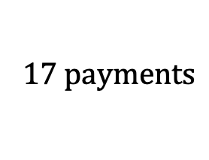
Symbolic Examples
Example 1: Symbolically represent the value of the annuity shown at the valuation date shown.
$$17 payments$$
$$4$$
$$4$$
$$⋯$$
$$4$$
$$⋯$$
$$months$$

Slide 3
Symbolic Examples
Example 1: Symbolically represent the value of the annuity shown at the valuation date shown.
$$17 payments$$
$$4$$
$$4$$
$$⋯$$
$$4$$
$$⋯$$
$$months$$

Slide 4

Symbolic Examples
Example 1: Symbolically represent the value of the annuity shown at the valuation date shown.
$$17 payments$$
$$4$$
$$4$$
$$⋯$$
$$4$$
$$⋯$$
$$months$$
$${4a}_{\overline{17|}}$$

Slide 5

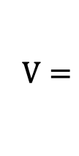
Symbolic Examples
Example 1: Symbolically represent the value of the annuity shown at the valuation date shown.
$$17 payments$$
$$4$$
$$4$$
$$⋯$$
$$4$$
$$⋯$$
$$months$$
$$V=$$
$${4a}_{\overline{17|}}∙v^{2}$$

Slide 6
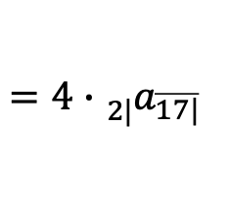
Symbolic Examples
Example 1: Symbolically represent the value of the annuity shown at the valuation date shown.
$$17 payments$$
$$4$$
$$4$$
$$⋯$$
$$4$$
$$⋯$$
$$months$$
$$V=$$
$${4a}_{\overline{17|}}∙v^{2}$$
$$=4∙{}_{2|}^{}{a_{\overline{17|}} }$$

Slide 7

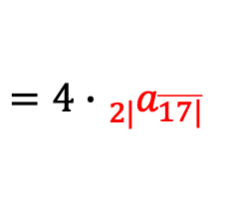
Symbolic Examples
Example 1: Symbolically represent the value of the annuity shown at the valuation date shown.
$$17 payments$$
$$4$$
$$4$$
$$⋯$$
$$4$$
$$⋯$$
$$months$$
$$V=$$
$$4a_{\overline{17|}}∙v^{2}$$
$$=4∙{}_{2|}^{}{a_{\overline{17|}} }$$

Slide 8

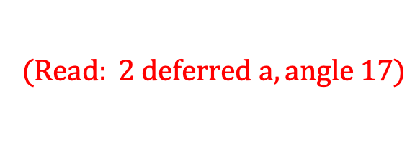
Symbolic Examples
Example 1: Symbolically represent the value of the annuity shown at the valuation date shown.
$$17 payments$$
$$4$$
$$4$$
$$⋯$$
$$4$$
$$⋯$$
$$months$$
$$V=$$
$$4a_{\overline{17|}}∙v^{2}$$
$$=4∙{}_{2|}^{}{a_{\overline{17|}} }$$
$$(Read: 2 deferred a, angle 17)$$

Slide 9
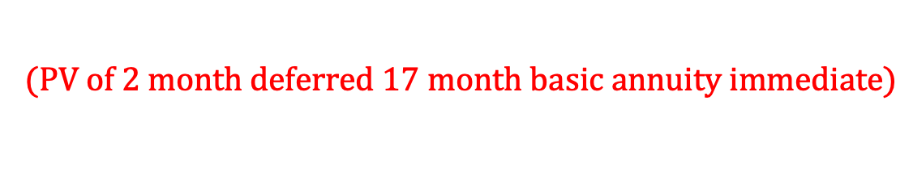
Symbolic Examples
Example 1: Symbolically represent the value of the annuity shown at the valuation date shown.
$$17 payments$$
$$4$$
$$4$$
$$⋯$$
$$4$$
$$⋯$$
$$months$$
$$V=$$
$$4a_{\overline{17|}}∙v^{2}$$
$$=4∙{}_{2|}^{}{a_{\overline{17|}} }$$
$$(Read: 2 deferred a, angle 17)$$
$$(PV of 2 month deferred 17 month basic annuity immediate)$$

Slide 10
Symbolic Examples
Example 1: Symbolically represent the value of the annuity shown at the valuation date shown.
$$17 payments$$
$$4$$
$$4$$
$$⋯$$
$$4$$
$$⋯$$
$$months$$

Slide 11
Symbolic Examples
Example 1: Symbolically represent the value of the annuity shown at the valuation date shown.
$$17 payments$$
$$4$$
$$4$$
$$⋯$$
$$4$$
$$⋯$$
$$months$$

Slide 12

Symbolic Examples
Example 1: Symbolically represent the value of the annuity shown at the valuation date shown.
$$17 payments$$
$$4$$
$$4$$
$$⋯$$
$$4$$
$$⋯$$
$$months$$
$${4\ddot{a}}_{\overline{17|}}$$

Slide 13

Symbolic Examples
Example 1: Symbolically represent the value of the annuity shown at the valuation date shown.
$$17 payments$$
$$4$$
$$4$$
$$⋯$$
$$4$$
$$⋯$$
$$months$$
$$V=$$
$${4\ddot{a}}_{\overline{17|}}∙v^{3}$$

Slide 14
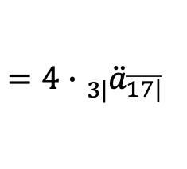
Symbolic Examples
Example 1: Symbolically represent the value of the annuity shown at the valuation date shown.
$$17 payments$$
$$4$$
$$4$$
$$⋯$$
$$4$$
$$⋯$$
$$months$$
$$V=$$
$${4\ddot{a}}_{\overline{17|}}∙v^{3}$$
$$=4∙{}_{3|}^{}{{\ddot{a}}_{\overline{17|}} }$$

Slide 15

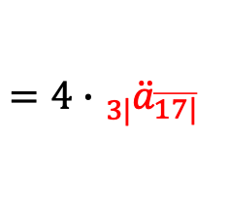
Symbolic Examples
Example 1: Symbolically represent the value of the annuity shown at the valuation date shown.
$$17 payments$$
$$4$$
$$4$$
$$⋯$$
$$4$$
$$⋯$$
$$months$$
$$V=$$
$$4{\ddot{a}}_{\overline{17|}}∙v^{3}$$
$$=4∙{}_{3|}^{}{{\ddot{a}}_{\overline{17|}} }$$

Slide 16
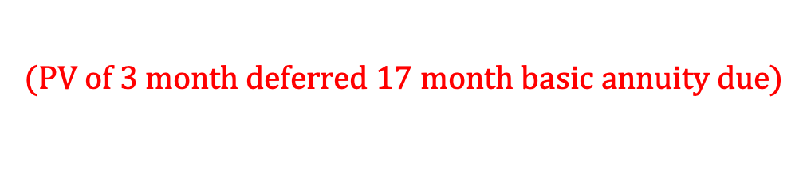
Symbolic Examples
Example 1: Symbolically represent the value of the annuity shown at the valuation date shown.
$$17 payments$$
$$4$$
$$4$$
$$⋯$$
$$4$$
$$⋯$$
$$months$$
$$V=$$
$$4{\ddot{a}}_{\overline{17|}}∙v^{3}$$
$$=4∙{}_{3|}^{}{{\ddot{a}}_{\overline{17|}} }$$
$$(PV of 3 month deferred 17 month basic annuity due)$$

Slide 17
Symbolic Examples
Example 1: Symbolically represent the value of the annuity shown at the valuation date shown.
$$17 payments$$
$$4$$
$$4$$
$$⋯$$
$$4$$
$$⋯$$
$$months$$

Slide 18
Symbolic Examples
Example 1: Symbolically represent the value of the annuity shown at the valuation date shown.
$$17 payments$$
$$4$$
$$4$$
$$⋯$$
$$4$$
$$⋯$$
$$months$$

Slide 19

Symbolic Examples
Example 1: Symbolically represent the value of the annuity shown at the valuation date shown.
$$17 payments$$
$$4$$
$$4$$
$$⋯$$
$$4$$
$$⋯$$
$$months$$
$${4s}_{\overline{17|}}$$

Slide 20

Symbolic Examples
Example 1: Symbolically represent the value of the annuity shown at the valuation date shown.
$$17 payments$$
$$4$$
$$4$$
$$⋯$$
$$4$$
$$⋯$$
$$months$$
$$V=$$
$${4s}_{\overline{17|}}∙v^{19}$$

Slide 21
Symbolic Examples
Example 1: Symbolically represent the value of the annuity shown at the valuation date shown.
$$17 payments$$
$$4$$
$$4$$
$$⋯$$
$$4$$
$$⋯$$
$$months$$
$$V=$$
$$4a_{\overline{17|}}∙v^{2}$$
$$=4∙{}_{2|}^{}{a_{\overline{17|}} }$$

Slide 22
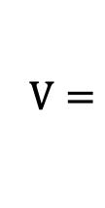
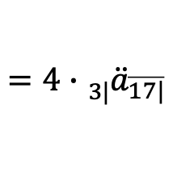

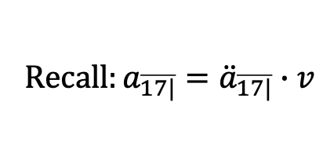
Symbolic Examples
Example 1: Symbolically represent the value of the annuity shown at the valuation date shown.
$$17 payments$$
$$4$$
$$4$$
$$⋯$$
$$4$$
$$⋯$$
$$months$$
$$V=$$
$$4a_{\overline{17|}}∙v^{2}$$
$$=4∙{}_{2|}^{}{a_{\overline{17|}} }$$
$$V=$$
$${4\ddot{a}}_{\overline{17|}}∙v^{3}$$
$$=4∙{}_{3|}^{}{{\ddot{a}}_{\overline{17|}} }$$
$$Recall:a_{\overline{17|}}={\ddot{a}}_{\overline{17|}}∙v$$

Slide 23

Symbolic Examples
Example 1: Symbolically represent the value of the annuity shown at the valuation date shown.
$$17 payments$$
$$4$$
$$4$$
$$⋯$$
$$4$$
$$⋯$$
$$months$$
$$V=$$
$$4a_{\overline{17|}}∙v^{2}$$
$$=4∙{}_{2|}^{}{a_{\overline{17|}} }$$
$$V=$$
$${4\ddot{a}}_{\overline{17|}}∙v^{3}$$
$$=4∙{}_{3|}^{}{{\ddot{a}}_{\overline{17|}} }$$
$$V=$$
$${4s}_{\overline{17|}}∙v^{19}$$

Slide 24
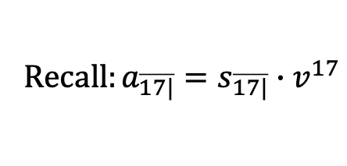

Symbolic Examples
Example 1: Symbolically represent the value of the annuity shown at the valuation date shown.
$$17 payments$$
$$4$$
$$4$$
$$⋯$$
$$4$$
$$⋯$$
$$months$$
$$V=$$
$$4a_{\overline{17|}}∙v^{2}$$
$$=4∙{}_{2|}^{}{a_{\overline{17|}} }$$
$$V=$$
$${4\ddot{a}}_{\overline{17|}}∙v^{3}$$
$$=4∙{}_{3|}^{}{{\ddot{a}}_{\overline{17|}} }$$
$$V=$$
$$4s_{\overline{17|}}∙v^{19}$$
$$Recall:a_{\overline{17|}}=s_{\overline{17|}}∙v^{17}$$

Slide 25
Symbolic Examples
Example 1: Symbolically represent the value of the annuity shown at the valuation date shown.
$$17 payments$$
$$4$$
$$4$$
$$⋯$$
$$4$$
$$⋯$$
$$months$$
$$V=$$
$$4a_{\overline{17|}}∙v^{2}$$
$$=4∙{}_{2|}^{}{a_{\overline{17|}} }$$
$$V=$$
$${4\ddot{a}}_{\overline{17|}}∙v^{3}$$
$$=4∙{}_{3|}^{}{{\ddot{a}}_{\overline{17|}} }$$

Slide 26


Symbolic Examples
Example 2: Symbolically represent the value of the perpetuity shown at the valuation date shown.
$$7$$
$$7$$
$$7$$
$$⋯$$
$$⋯$$
$$months$$

Slide 27

Symbolic Examples
Example 2: Symbolically represent the value of the perpetuity shown at the valuation date shown.
$$7$$
$$7$$
$$7$$
$$⋯$$
$$⋯$$
$$months$$
$$q=qeir$$

Slide 28
Symbolic Examples
Example 2: Symbolically represent the value of the perpetuity shown at the valuation date shown.
$$7$$
$$7$$
$$7$$
$$⋯$$
$$⋯$$
$$months$$
$$q=qeir$$

Slide 29

Symbolic Examples
Example 2: Symbolically represent the value of the perpetuity shown at the valuation date shown.
$$7$$
$$7$$
$$7$$
$$⋯$$
$$⋯$$
$$months$$
$$q=qeir$$
$${7\ddot{a}}_{\overline{∞|}}$$

Slide 30


Symbolic Examples
Example 2: Symbolically represent the value of the perpetuity shown at the valuation date shown.
$$7$$
$$7$$
$$7$$
$$⋯$$
$$⋯$$
$$months$$
$$q=qeir$$
$$m=meir$$
$${7\ddot{a}}_{\overline{∞|}}$$

Slide 31

Symbolic Examples
Example 2: Symbolically represent the value of the perpetuity shown at the valuation date shown.
$$7$$
$$7$$
$$7$$
$$⋯$$
$$⋯$$
$$months$$
$$q=qeir$$
$$m=meir$$
$${7\ddot{a}}_{\overline{∞|}q}$$

Slide 32

Symbolic Examples
Example 2: Symbolically represent the value of the perpetuity shown at the valuation date shown.
$$7$$
$$7$$
$$7$$
$$⋯$$
$$⋯$$
$$months$$
$$q=qeir$$
$$m=meir$$
$$V={7\ddot{a}}_{\overline{∞|}q}∙v_{m}^{2}$$

Slide 33


Symbolic Examples
Example 2: Symbolically represent the value of the perpetuity shown at the valuation date shown.
$$7$$
$$7$$
$$7$$
$$⋯$$
$$⋯$$
$$months$$
$$q=qeir$$
$$m=meir$$
$$v=\frac{1}{1+i}$$
$$V={7\ddot{a}}_{\overline{∞|}q}∙v_{m}^{2}$$
$$=pdf$$

Slide 34


Symbolic Examples
Example 2: Symbolically represent the value of the perpetuity shown at the valuation date shown.
$$7$$
$$7$$
$$7$$
$$⋯$$
$$⋯$$
$$months$$
$$q=qeir$$
$$m=meir$$
$$v_{m}=\frac{1}{1+m}$$
$$V={7\ddot{a}}_{\overline{∞|}q}∙v_{m}^{2}$$
$$=mdf$$

Slide 35
Symbolic Examples
Example 2: Symbolically represent the value of the perpetuity shown at the valuation date shown.
$$7$$
$$7$$
$$7$$
$$⋯$$
$$⋯$$
$$months$$
$$q=qeir$$
$${7\ddot{a}}_{\overline{∞|}}$$

Slide 36

Symbolic Examples
Example 2: Symbolically represent the value of the perpetuity shown at the valuation date shown.
$$7$$
$$7$$
$$7$$
$$⋯$$
$$⋯$$
$$months$$
$$q=qeir$$
$${7\ddot{a}}_{\overline{∞|}}$$
$$2 months=\frac{2}{3}quarters$$

Slide 37
Symbolic Examples
Example 2: Symbolically represent the value of the perpetuity shown at the valuation date shown.
$$7$$
$$7$$
$$7$$
$$⋯$$
$$⋯$$
$$months$$
$$q=qeir$$
$$v_{m}=\frac{1}{1+m}$$
$${7\ddot{a}}_{\overline{∞|}}$$
$$=mdf$$
$$2 months=\frac{2}{3}quarters$$

Slide 38

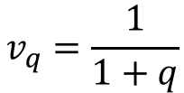
Symbolic Examples
Example 2: Symbolically represent the value of the perpetuity shown at the valuation date shown.
$$7$$
$$7$$
$$7$$
$$⋯$$
$$⋯$$
$$months$$
$$q=qeir$$
$$v_{q}=\frac{1}{1+q}$$
$${7\ddot{a}}_{\overline{∞|}}$$
$$=qdf$$
$$2 months=\frac{2}{3}quarters$$

Slide 39
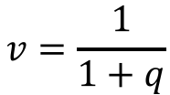

Symbolic Examples
Example 2: Symbolically represent the value of the perpetuity shown at the valuation date shown.
$$7$$
$$7$$
$$7$$
$$⋯$$
$$⋯$$
$$months$$
$$q=qeir$$
$$V={7\ddot{a}}_{\overline{∞|}}∙v^{\frac{2}{3}}$$
$$v=\frac{1}{1+q}$$
$$=qdf$$

Slide 40
Symbolic Examples
Example 2: Symbolically represent the value of the perpetuity shown at the valuation date shown.
$$7$$
$$7$$
$$7$$
$$⋯$$
$$⋯$$
$$months$$
$$q=qeir$$
$$m=meir$$
$$v_{m}=\frac{1}{1+m}$$
$$V={7\ddot{a}}_{\overline{∞|}q}∙v_{m}^{2}$$
$$=mdf$$

Slide 41
Symbolic Examples
Example 2: Symbolically represent the value of the perpetuity shown at the valuation date shown.
$$7$$
$$7$$
$$7$$
$$⋯$$
$$⋯$$
$$months$$
$$q=qeir$$
$$V={7\ddot{a}}_{\overline{∞|}}∙v^{\frac{2}{3}}$$
$$v=\frac{1}{1+q}$$
$$=qdf$$

Slide 42
Symbolic Examples
Example 2: Symbolically represent the value of the perpetuity shown at the valuation date shown.
$$7$$
$$7$$
$$7$$
$$⋯$$
$$⋯$$
$$months$$
$$q=qeir$$

Slide 43

Symbolic Examples
Example 2: Symbolically represent the value of the perpetuity shown at the valuation date shown.
$$7$$
$$7$$
$$7$$
$$⋯$$
$$⋯$$
$$months$$
$$q=qeir$$
$${7a}_{\overline{∞|}}$$

Slide 44
Symbolic Examples
Example 2: Symbolically represent the value of the perpetuity shown at the valuation date shown.
$$7$$
$$7$$
$$7$$
$$⋯$$
$$⋯$$
$$months$$
$$q=qeir$$
$${7a}_{\overline{∞|}}$$

Slide 45
Symbolic Examples
Example 2: Symbolically represent the value of the perpetuity shown at the valuation date shown.
$$7$$
$$7$$
$$7$$
$$⋯$$
$$⋯$$
$$months$$
$$q=qeir$$
$${7a}_{\overline{∞|}}$$

Slide 46

Symbolic Examples
Example 2: Symbolically represent the value of the perpetuity shown at the valuation date shown.
$$7$$
$$7$$
$$7$$
$$⋯$$
$$⋯$$
$$months$$
$$q=qeir$$
$${7a}_{\overline{∞|}q}$$

Slide 47
Symbolic Examples
Example 2: Symbolically represent the value of the perpetuity shown at the valuation date shown.
$$7$$
$$7$$
$$7$$
$$⋯$$
$$⋯$$
$$months$$
$$q=qeir$$
$${7a}_{\overline{∞|}q}$$

Slide 48
Symbolic Examples
Example 2: Symbolically represent the value of the perpetuity shown at the valuation date shown.
$$7$$
$$7$$
$$7$$
$$⋯$$
$$⋯$$
$$months$$
$$q=qeir$$
$$m=meir$$
$${7a}_{\overline{∞|}q}$$

Slide 49

Symbolic Examples
Example 2: Symbolically represent the value of the perpetuity shown at the valuation date shown.
$$7$$
$$7$$
$$7$$
$$⋯$$
$$⋯$$
$$months$$
$$q=qeir$$
$$m=meir$$
$$V={7a}_{\overline{∞|}q}∙(1+m)$$

Slide 50


Symbolic Examples
Example 2: Symbolically represent the value of the perpetuity shown at the valuation date shown.
$$7$$
$$7$$
$$7$$
$$⋯$$
$$⋯$$
$$months$$
$$q=qeir$$
$$m=meir$$
$$v_{m}=\frac{1}{1+m}$$
$$V={7a}_{\overline{∞|}q}∙(1+m)$$
$$=mdf$$

Slide 51

Symbolic Examples
Example 2: Symbolically represent the value of the perpetuity shown at the valuation date shown.
$$7$$
$$7$$
$$7$$
$$⋯$$
$$⋯$$
$$months$$
$$q=qeir$$
$$m=meir$$
$$v_{m}=\frac{1}{1+m}$$
$$V={7a}_{\overline{∞|}q}∙v_{m}^{−1}$$
$$=mdf$$

Slide 52
Symbolic Examples
Example 2: Symbolically represent the value of the perpetuity shown at the valuation date shown.
$$7$$
$$7$$
$$7$$
$$⋯$$
$$⋯$$
$$months$$
$$q=qeir$$
$${7a}_{\overline{∞|}}$$

Slide 53

Symbolic Examples
Example 2: Symbolically represent the value of the perpetuity shown at the valuation date shown.
$$7$$
$$7$$
$$7$$
$$⋯$$
$$⋯$$
$$months$$
$$q=qeir$$
$${7a}_{\overline{∞|}}$$
$$1 month=\frac{1}{3}quarters$$

Slide 54

Symbolic Examples
Example 2: Symbolically represent the value of the perpetuity shown at the valuation date shown.
$$7$$
$$7$$
$$7$$
$$⋯$$
$$⋯$$
$$months$$
$$q=qeir$$
$$V={7a}_{\overline{∞|}}∙{(1+q)}^{\frac{1}{3}}$$

Slide 55
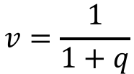

Symbolic Examples
Example 2: Symbolically represent the value of the perpetuity shown at the valuation date shown.
$$7$$
$$7$$
$$7$$
$$⋯$$
$$⋯$$
$$months$$
$$q=qeir$$
$$V={7a}_{\overline{∞|}}∙{(1+q)}^{\frac{1}{3}}$$
$$v=\frac{1}{1+q}$$
$$=qdf$$

Slide 56

Symbolic Examples
Example 2: Symbolically represent the value of the perpetuity shown at the valuation date shown.
$$7$$
$$7$$
$$7$$
$$⋯$$
$$⋯$$
$$months$$
$$q=qeir$$
$$V={7a}_{\overline{∞|}}∙v^{−\frac{1}{3}}$$
$$v=\frac{1}{1+q}$$
$$=qdf$$

Slide 57

Symbolic Examples
Example 2: Symbolically represent the value of the perpetuity shown at the valuation date shown.
$$7$$
$$7$$
$$7$$
$$⋯$$
$$⋯$$
$$months$$
$$q=qeir$$
$$V={7a}_{\overline{∞|}}∙v^{−\frac{1}{3}}$$
$$v=\frac{1}{1+q}$$
$$=qdf$$
$$V={7\ddot{a}}_{\overline{∞|}}∙v^{\frac{2}{3}}$$

